Slide 1

Practical Guide to Unlocking Accessibility of Websites
Using WAVE to Identify and Address Accessibility Issues

Slide 2




Agenda
Introduction
Legal and Ethical Obligations
Principles of Accessibility (POUR)
Common Accessibility Issues
Introducing WAVE Tool
WAVE Interface Overview
Interpreting WAVE Results
Fixing Accessibility Errors (Examples)
Best Practices for Accessibility
Integrating Accessibility into Workflow
Resources

Slide 3



Nurhak Kaya
Solutions Architect and Lead Developer
Umbraco MVPx4
Blogger, Speaker, Open-Source Contributor, Meetup Organiser

Slide 4

Introduction

Slide 5
What is Web Accessibility?
Designing and developing websites so that people can
Perceive
Understand
Navigate
Interact with them effectively.
It benefits all users, especially
People with disabilities
Older users with changing abilities
Users with temporary impairments
People using mobile devices or slow internet connections.

Slide 6
Importance of an Inclusive Web
Equal access for all users.
Contribute to a fairer and usable digital space.
Required by law for EU and UK (and many others).

Slide 7
Who benefits from accessible websites?
Not just
People with disabilities
Elderly users
Users with situational limitations
Those using assistive technologies
Accessibility is for everyone.

Slide 8
Legal and Ethical Obligations

Slide 9
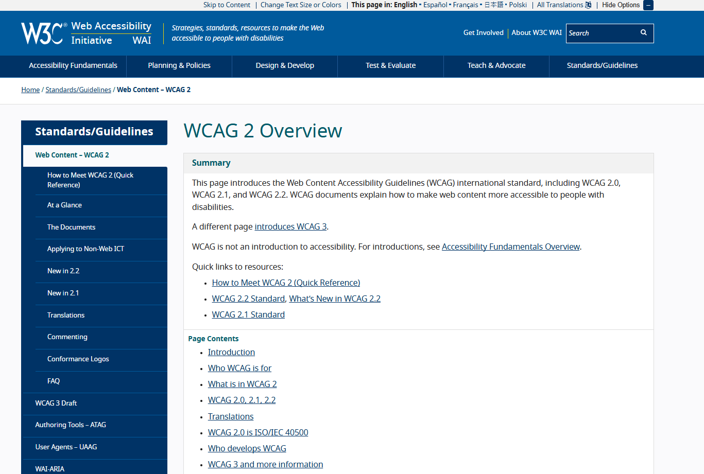
Overview of WCAG (Web Content Accessibility Guidelines)
A set of technical standards for improving web accessibility.
Developed through the W3C process in cooperation with individuals and organisations around the world, to provide a single shared standard for web content accessibility that meets the needs of individuals, organisations, and governments internationally.
https://www.w3.org/WAI/standards-guidelines/wcag/

Slide 10
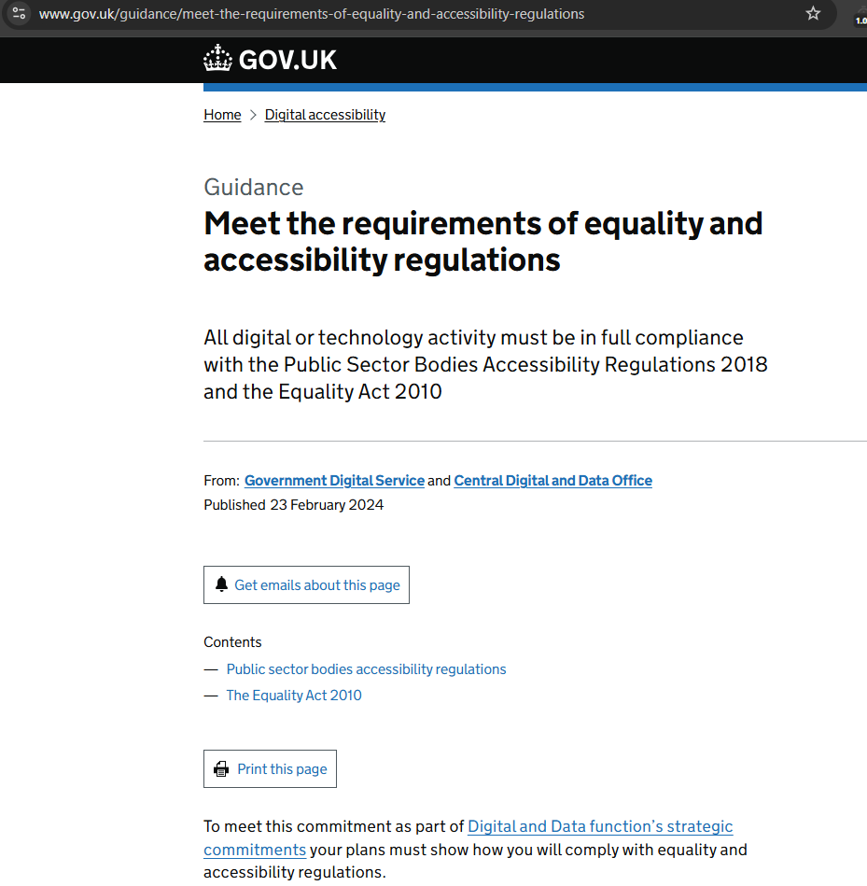
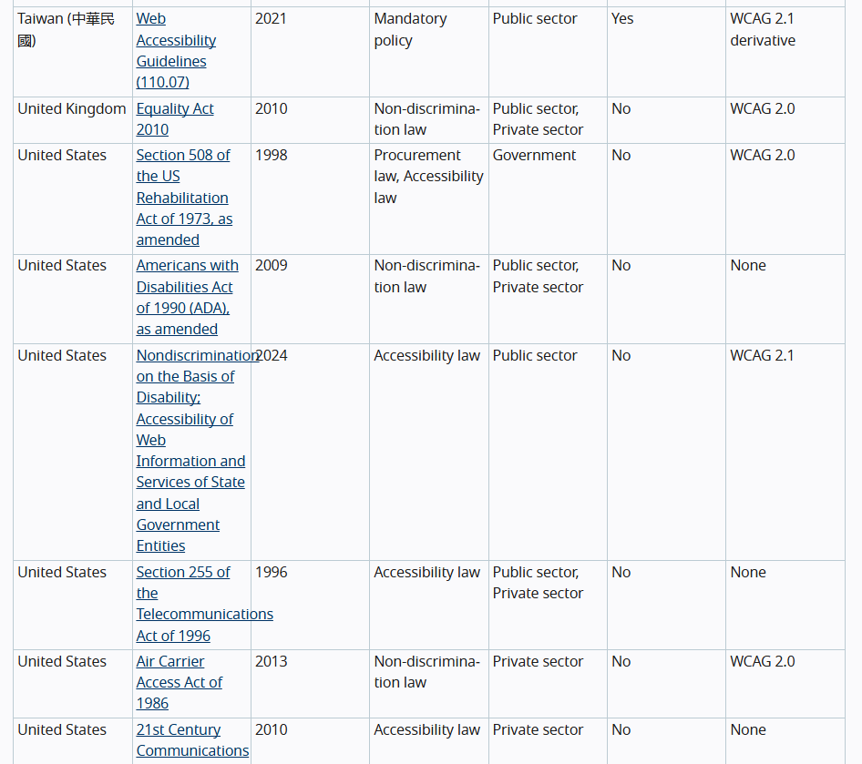
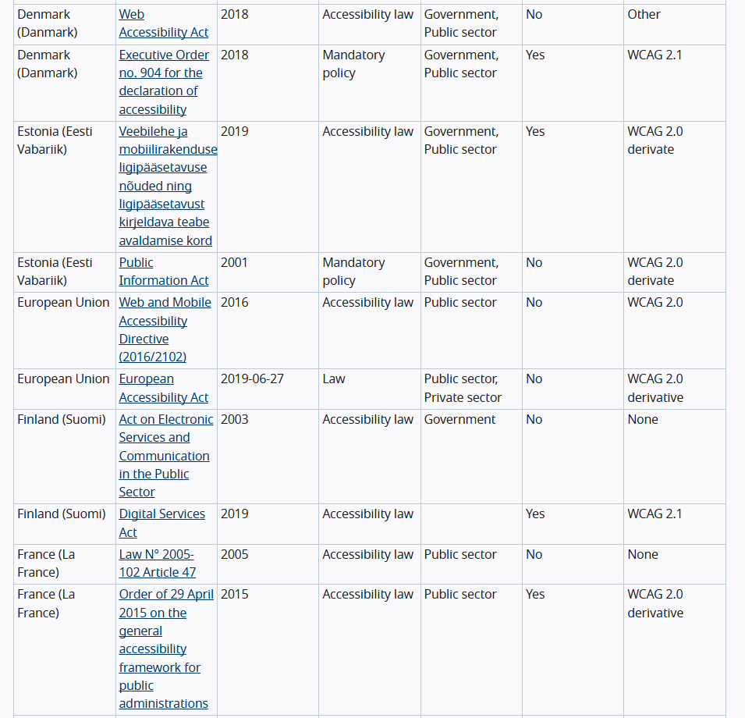
Accessibility Law–WCAG Version Based On
Various regional and international regulations mandating accessibility.
https://www.w3.org/WAI/policies/

Slide 11
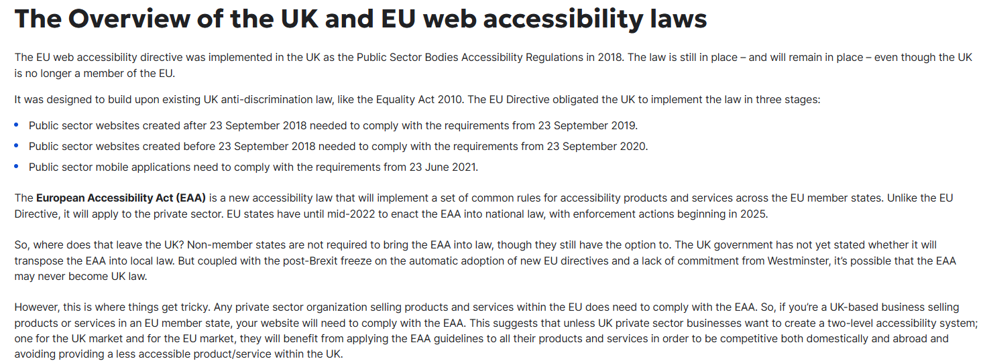
UK and EU Web Accessibility Laws
https://www.w3.org/WAI/policies/
https://www.siteimprove.com/glossary/uk-accessibility-laws/

Slide 12
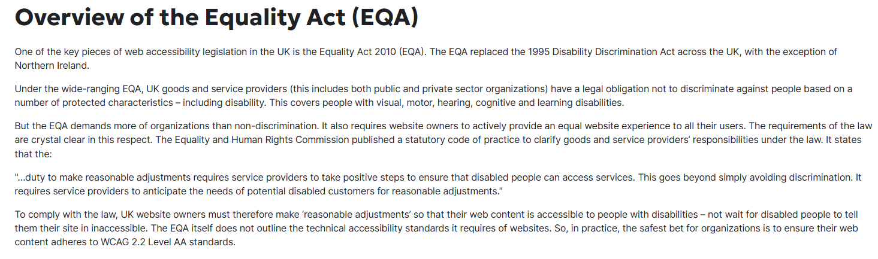
UK Equality Act 2010 (EQA)
https://www.siteimprove.com/glossary/uk-accessibility-laws/

Slide 13
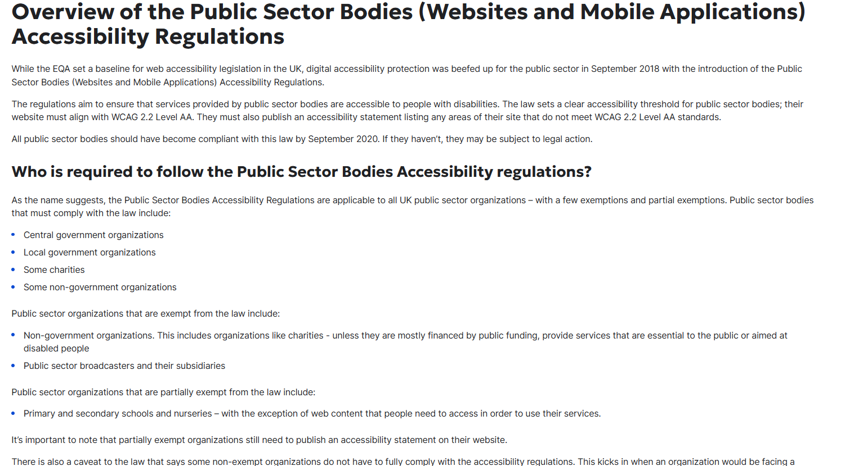
UK Public Sector Bodies
https://www.siteimprove.com/glossary/uk-accessibility-laws/

Slide 14
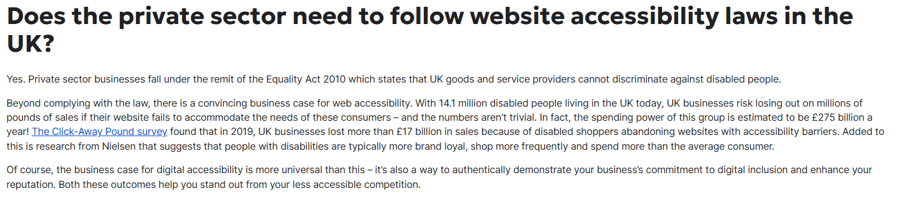
UK Private Sector
https://www.siteimprove.com/glossary/uk-accessibility-laws/

Slide 15
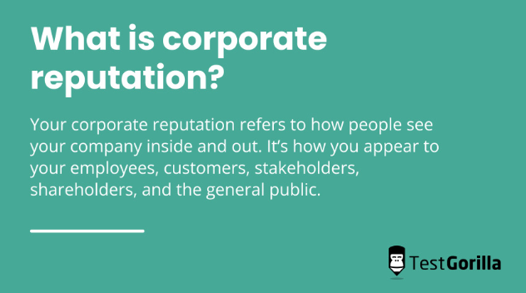
Reputation and SEO benefits
Accessible sites often rank better in search engines.
Accessible sites reflect positively on the brand.

Slide 16

Principles of Accessibility (POUR)

Slide 17
Principles of Accessibility (POUR)
Principles to guide the creation of inclusive and accessible content, ensuring that it can be used by everyone, including people with disabilities.
Perceivable
Operable
Understandable
Robust
Information and UI must be presented in ways users can perceive (e.g., text alternatives for images).
Interface components must be usable via keyboard and other means.
Content must be clear and predictable to minimize confusion.
Content must be compatible with current and future assistive technologies.

Slide 18
Common Accessibility Issues

Slide 19
Common Accessibility Issues
Missing alt text on images
Screen readers rely on alt text to describe images to visually impaired users.
Poor colour contrast
Insufficient contrast can make text hard to read for users with visual impairments.
Improper heading structure
Heading levels should follow a logical order to aid navigation.
Non-descriptive links
Links like "Click here" don't provide context about their destination.
Keyboard navigation issues
Some users rely solely on keyboards; interfaces should accommodate this.

Slide 20
Introducing WAVE Tool

Slide 21
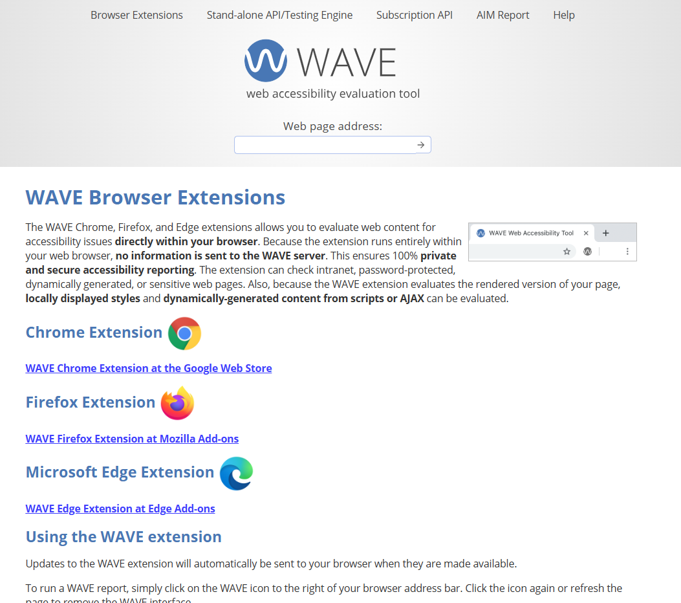
What is WAVE (Web Accessibility Evaluation Tool)?
A free tool to help developers identify accessibility issues on web pages.
Developed by WebAIM (Web Accessibility in Mind), a leader in accessibility education.
Available as Chrome/Firefox/Microsoft Edge extensions or via the WAVE website.
While WAVE can identify many accessibility errors automatically, a person must identify many accessibility issues manually.
https://wave.webaim.org/

Slide 22
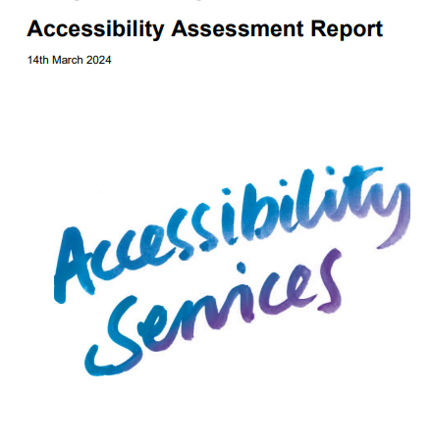
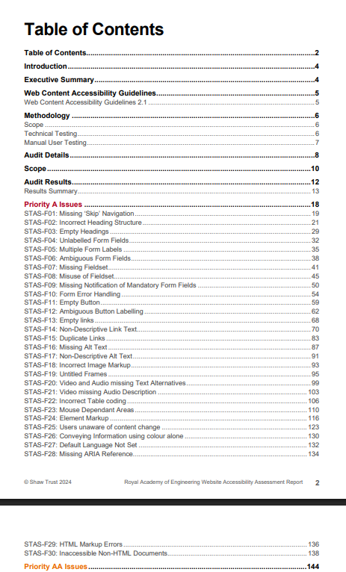
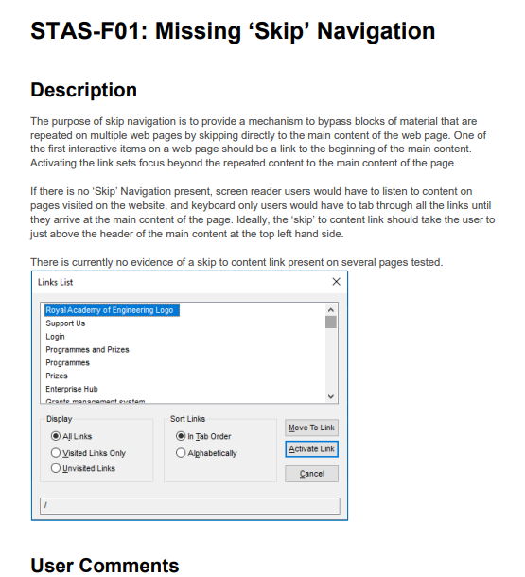
Why I use WAVE?
Saves me time. I can see issues on pages directly. Address them and test them again quickly.
I can resolve all problems for all pages, rather than just the ones mentioned on the Accessibility Report.
Accessibility Reports are generally very long to read and not super clear. WAVE helps me understand issues and potential fixes much quicker.

Slide 23
WAVE Interface Overview & Interpreting WAVE Results

Slide 24
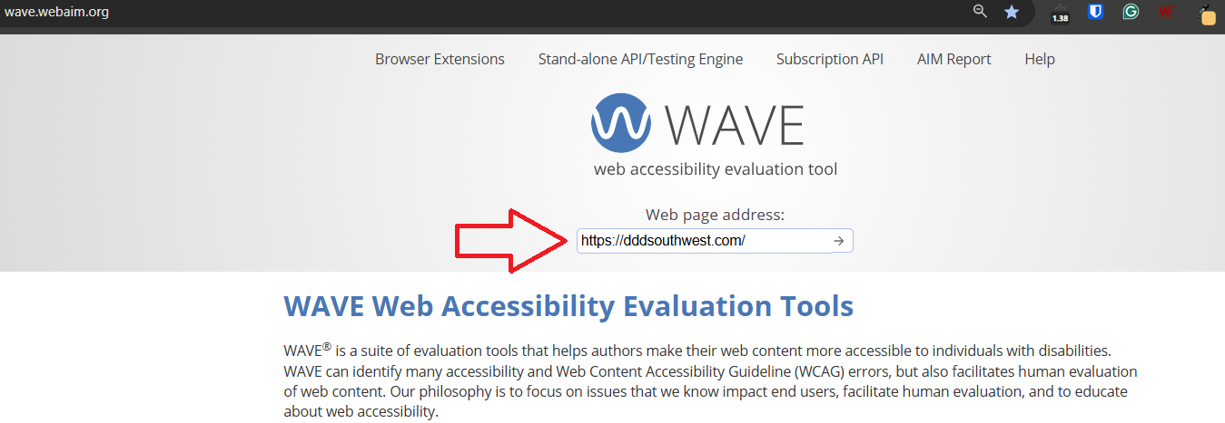
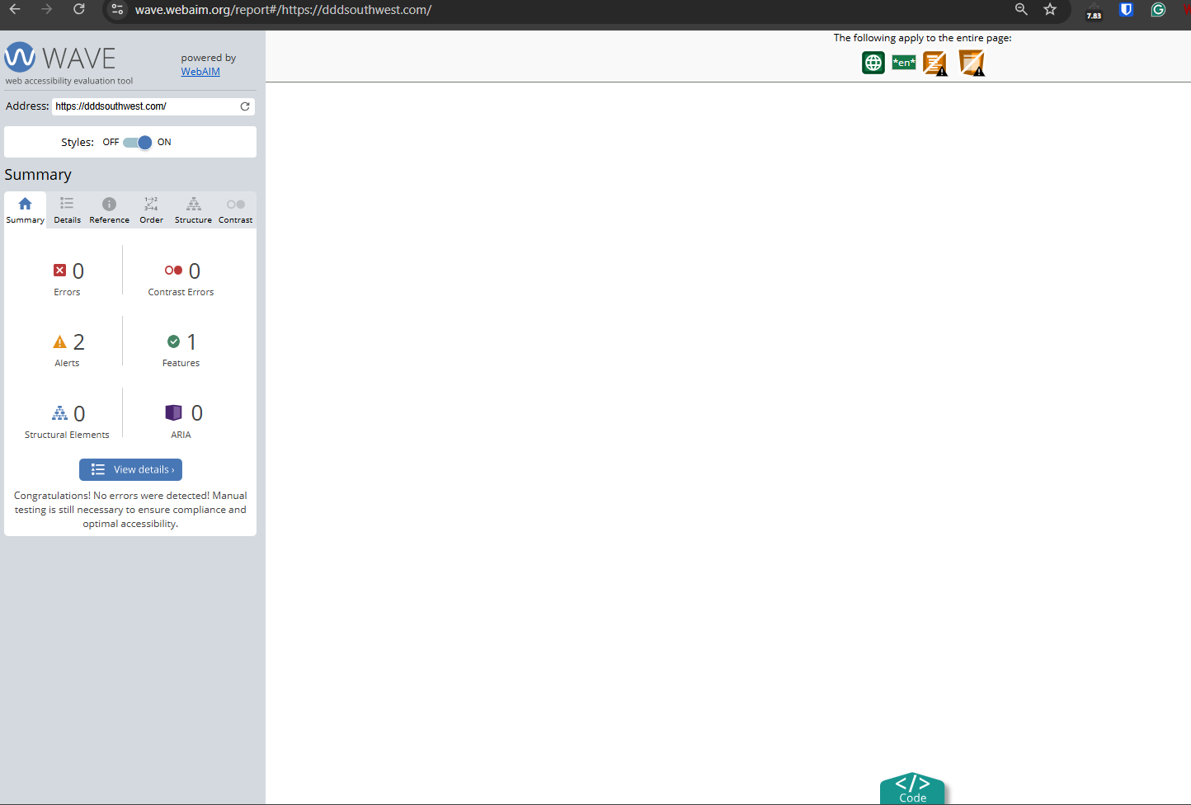
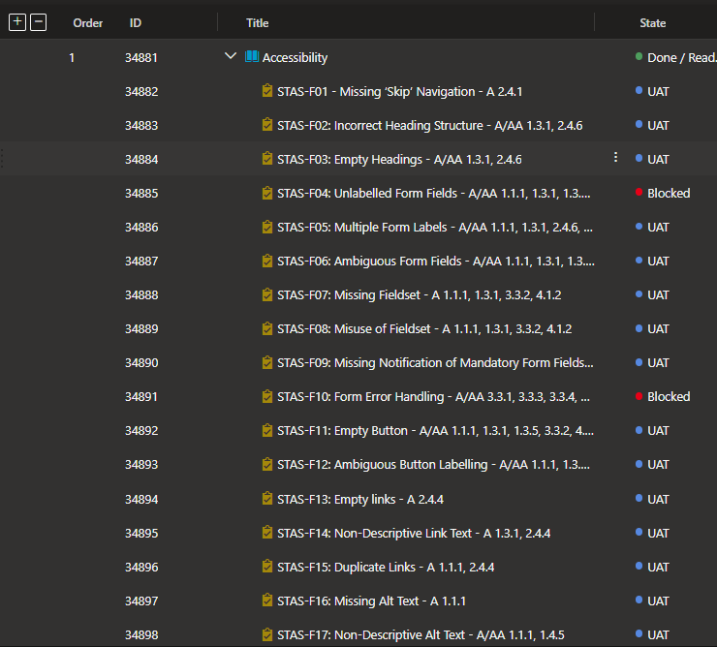
Testing a page
Enter the address of the web URL and hit Enter to start a test.
On the next page, WAVE highlights information that is important in an accessibility evaluation with inline icons. It also displays a summary of its findings in a sidebar on the left of the window.
These findings are organised into six categories.

Slide 25
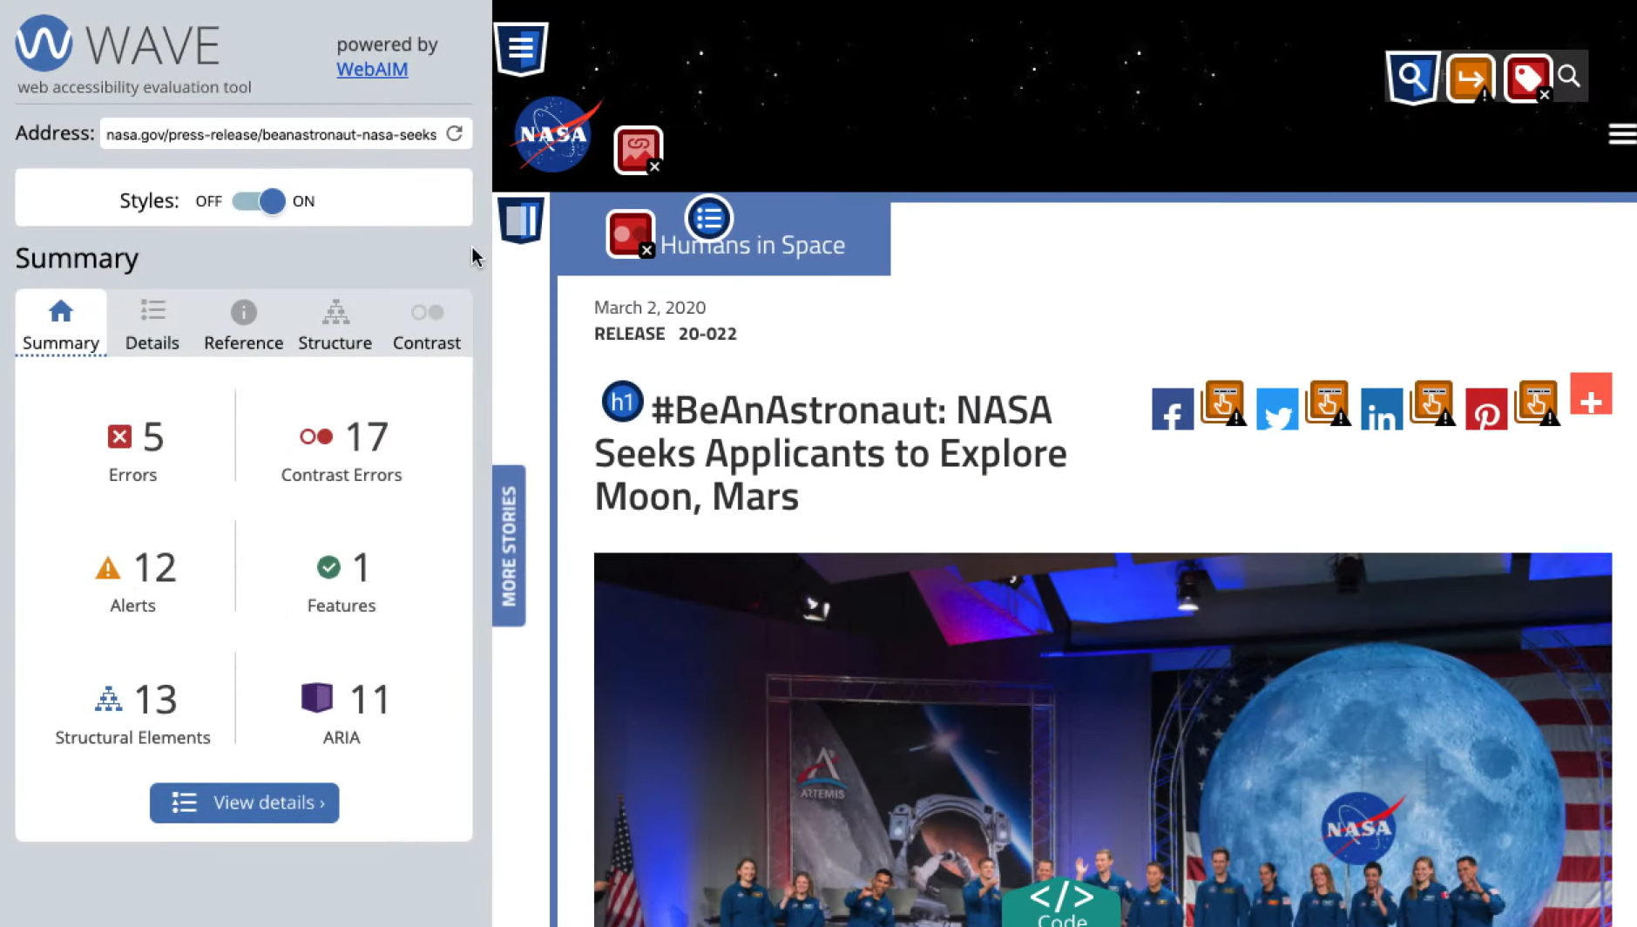
Summary panel
Provides a summary of all errors. The Details section is used to get more details.

Slide 26
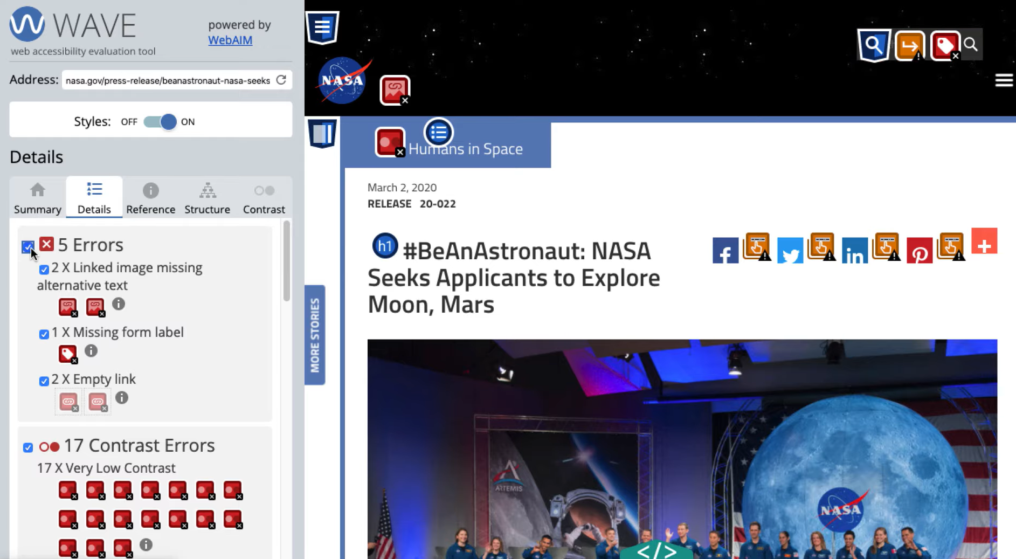
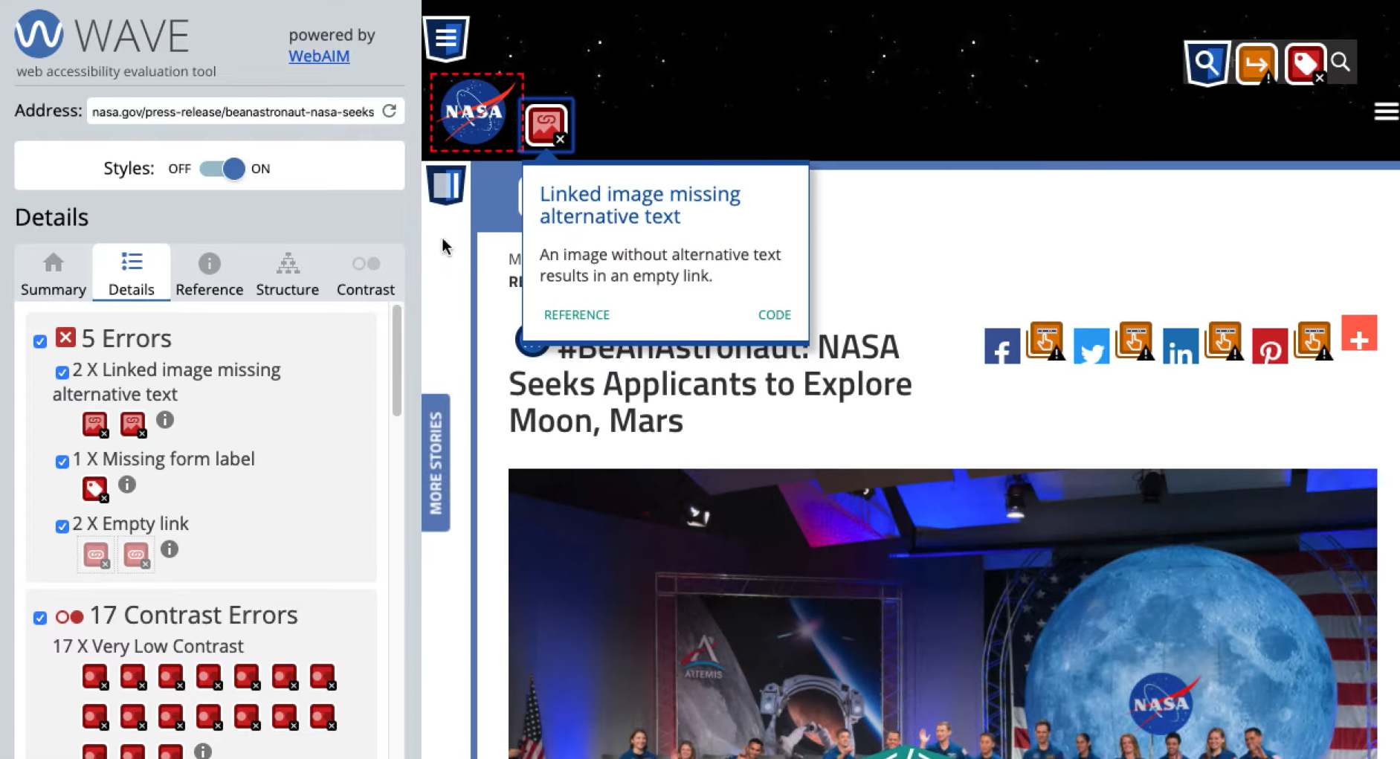
Details panel
Errors are issues that will impact certain users and failures to meet WCAG. Errors are grouped by category, and clicking on them displays error details on the page.
Alerts are elements that may cause issues and an evaluator must decide the impact.

Slide 27
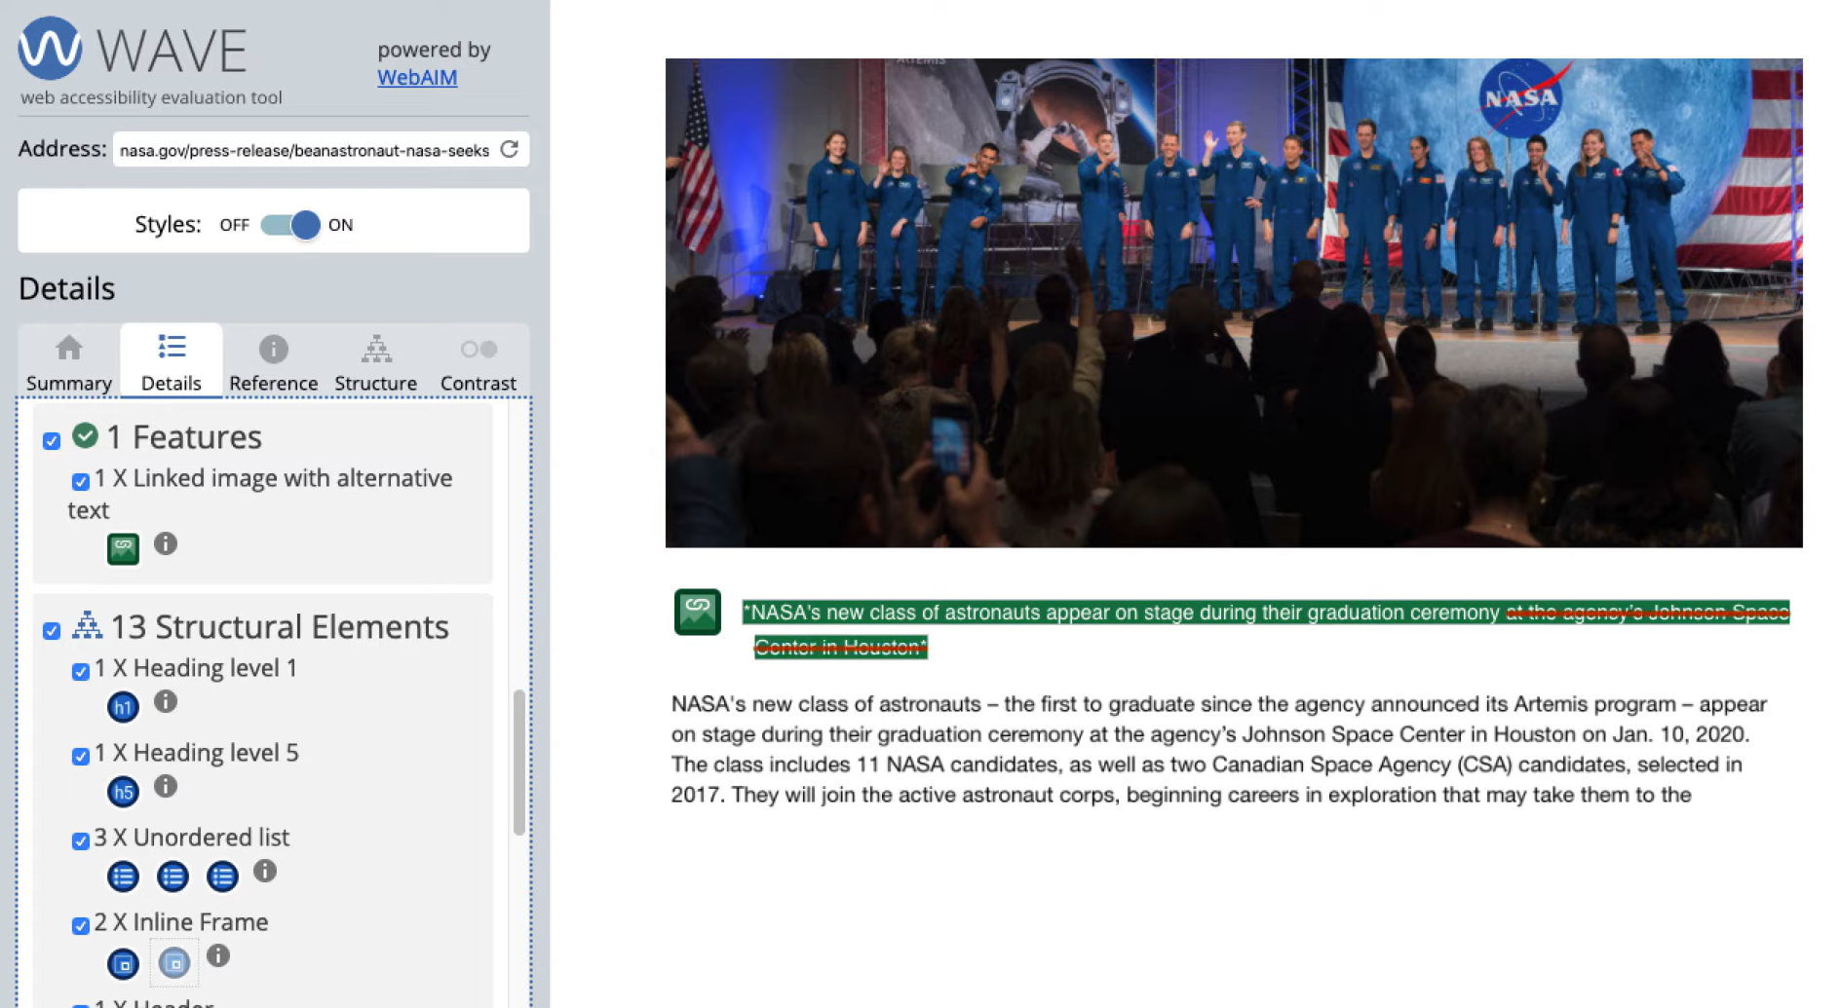
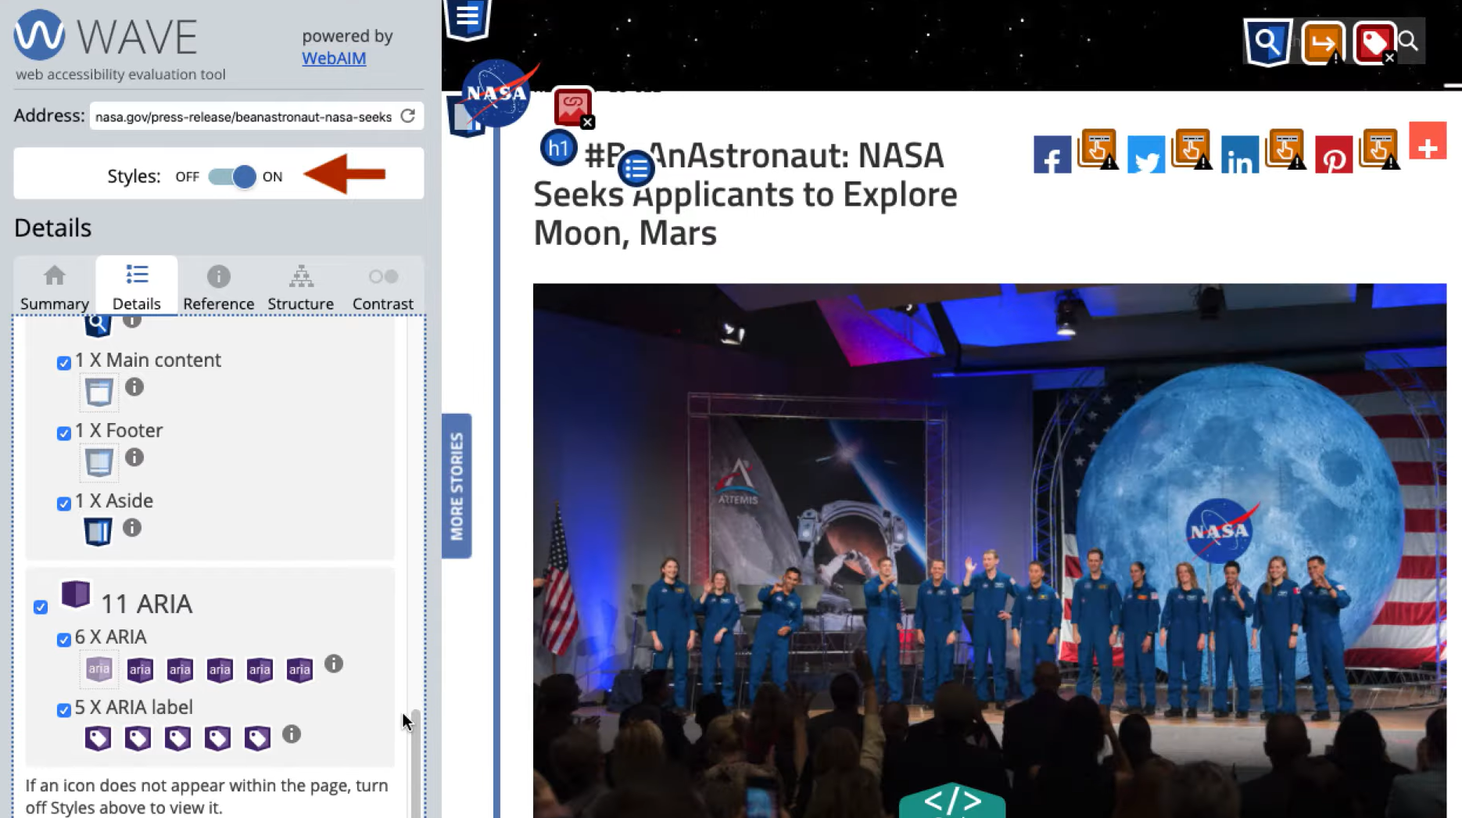
Details panel
Green icons indicate Features that will improve accessibility.
Blue icons are structural elements.
Purple icons are where ARIA has been used. ARIA can be used to present important accessibility information to people with disabilities.
A website will be less accessible if ARIA is used incorrectly.

Slide 28
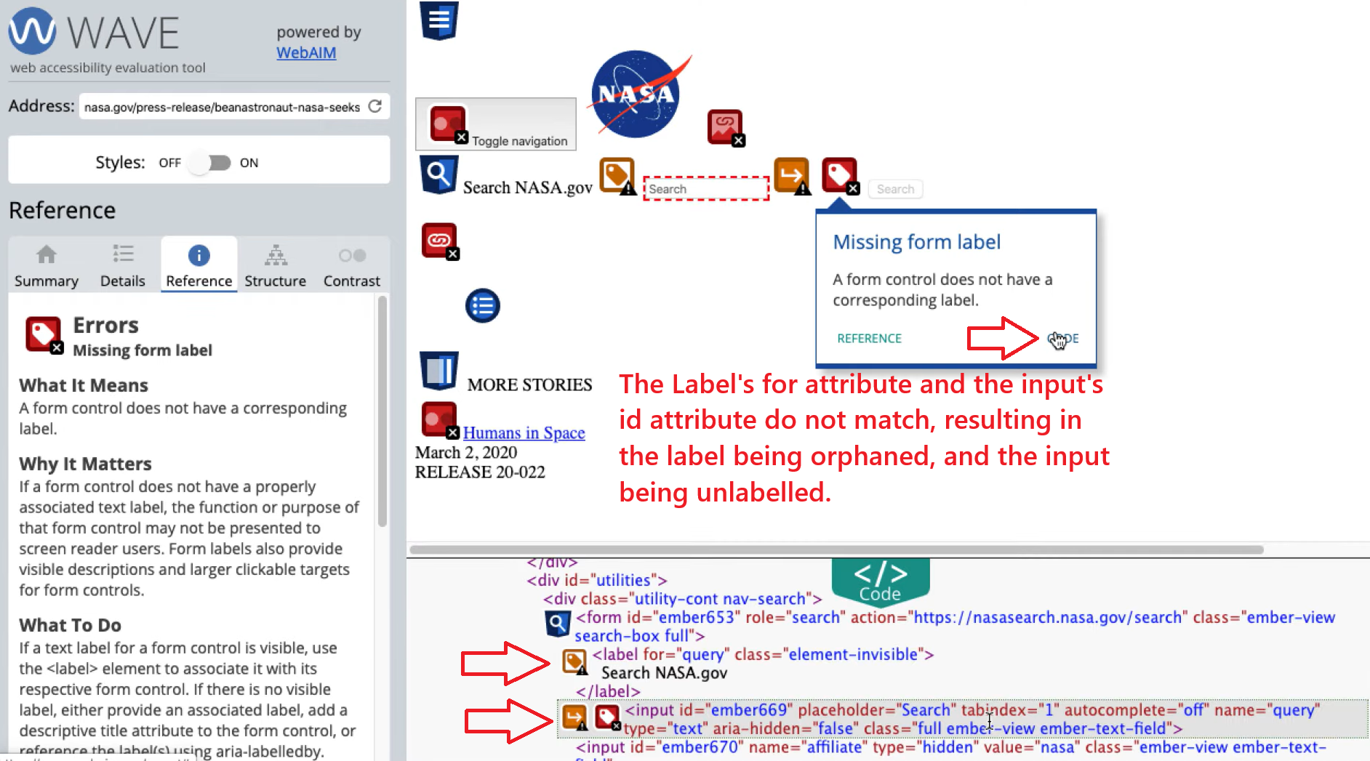
Reference panel
Provides explanations and links to WCAG guidelines. Clicking on Code reveals the problem.

Slide 29
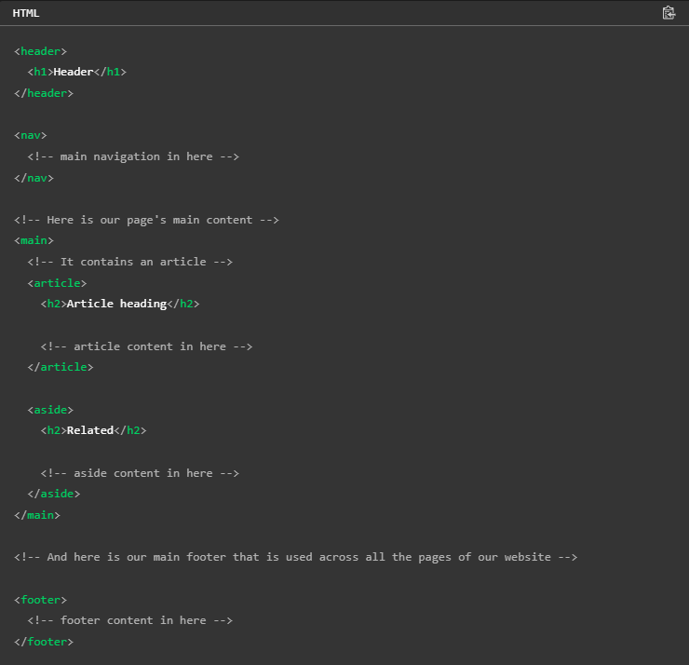
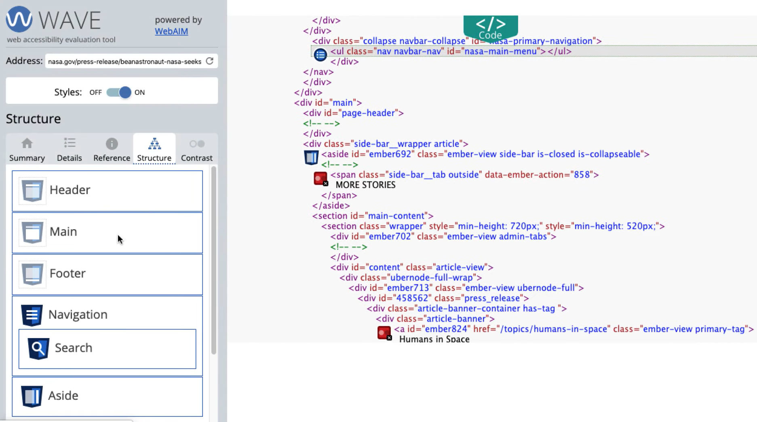
Structure panel
Shows page regions that have been identified with HTML or ARIA.
Identifies hidden elements, lists regions and headings in order.
Indicates any nesting of elements.
Incorrect sectioning of elements will cause accessibility issues.

Slide 30
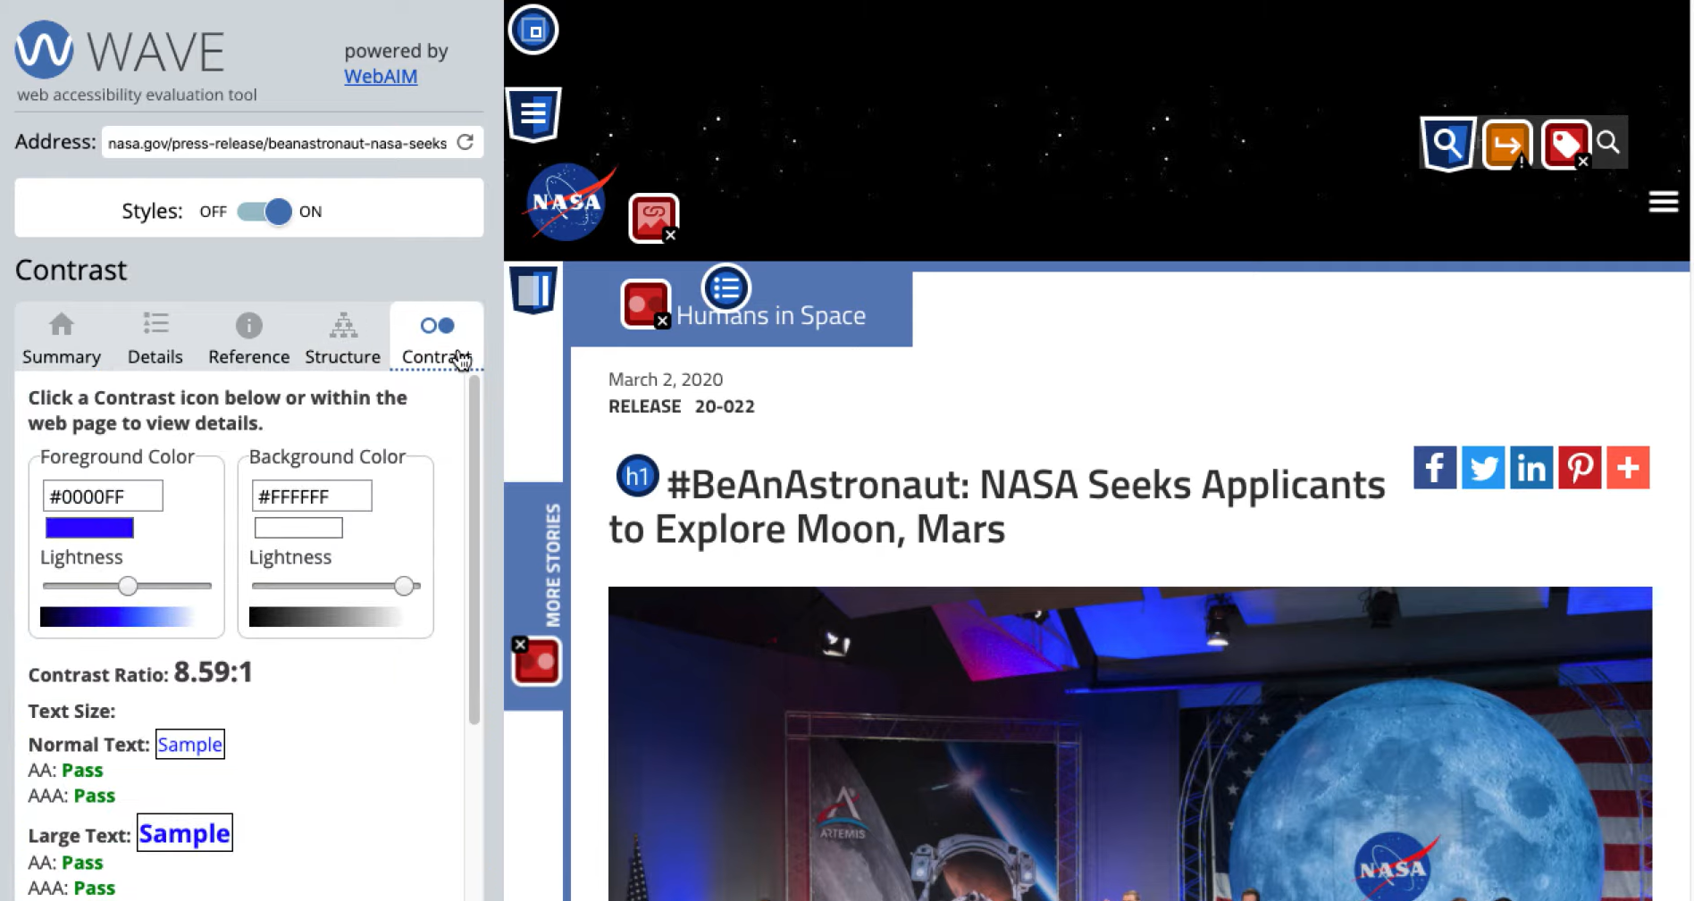
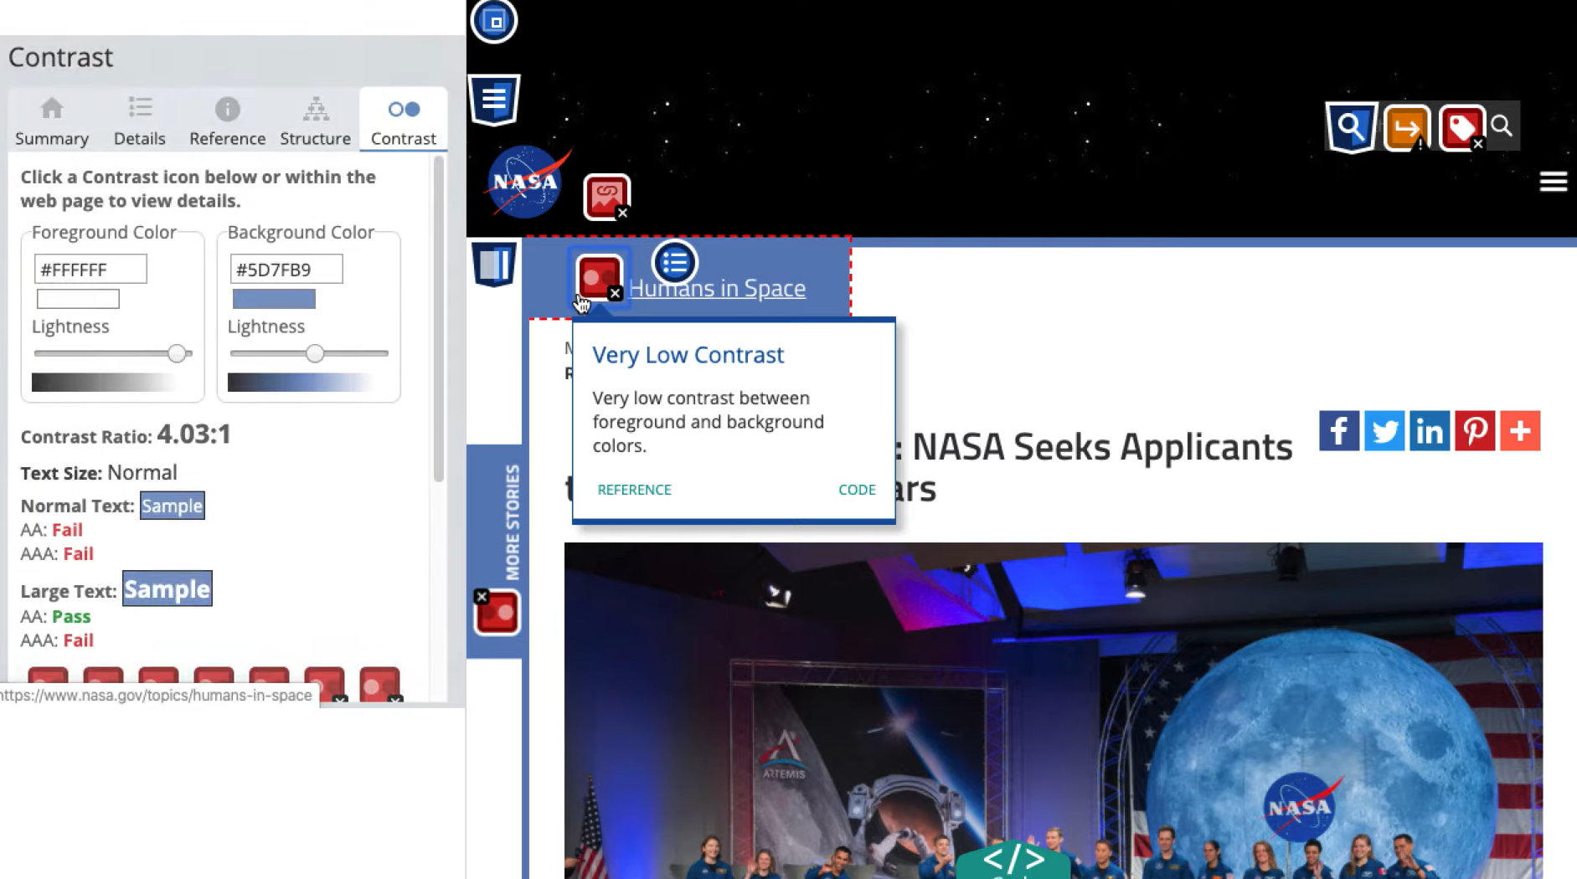
Contrast panel
Highlights colour contrast issues.

Slide 31
Fixing Accessibility Errors (Examples)

Slide 32
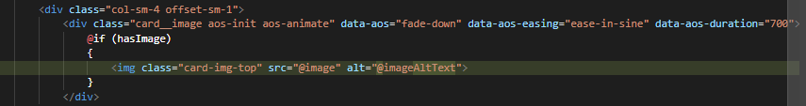
Add missing alt text
Describe the function or content of images clearly.

Slide 33
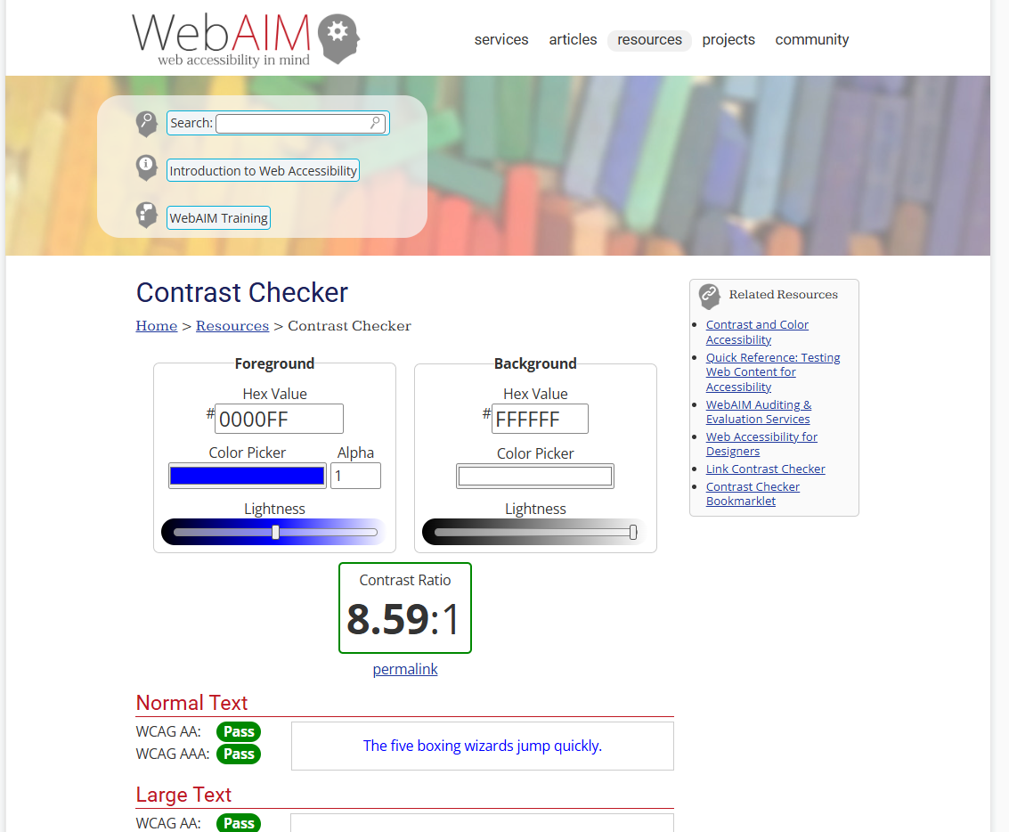
Correct colour contrast
Adjust text/background colours to meet WCAG contrast ratios.
Related resources:
https://webaim.org/resources/contrastchecker/
https://webaim.org/articles/contrast/
https://webaim.org/resources/evalquickref/
https://webaim.org/services/evaluation/
https://webaim.org/resources/designers/
https://webaim.org/resources/contrastchecker/bookmarklet

Slide 34

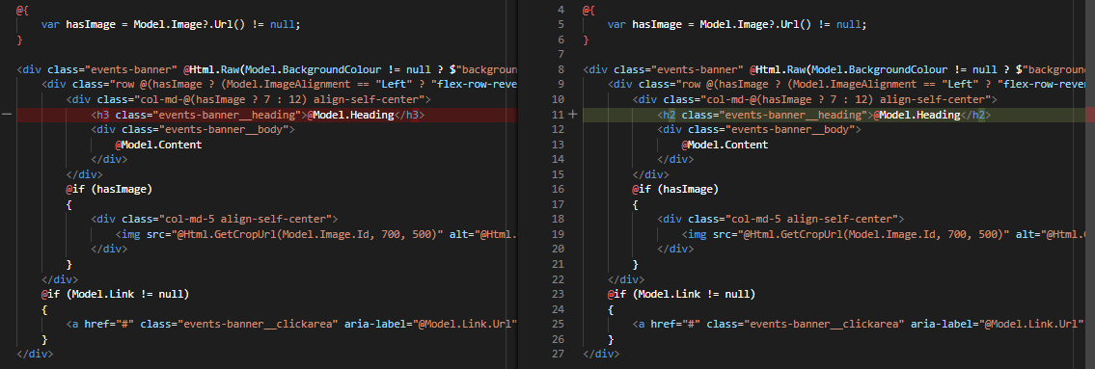
Use semantic HTML for headings
Apply to tags in a meaningful, nested order.

Slide 35
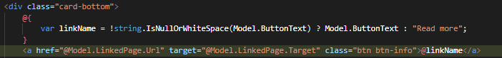
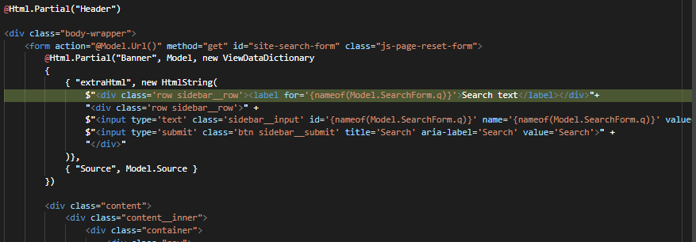
Improve link descriptions
Make link text descriptive of the target page.

Slide 36
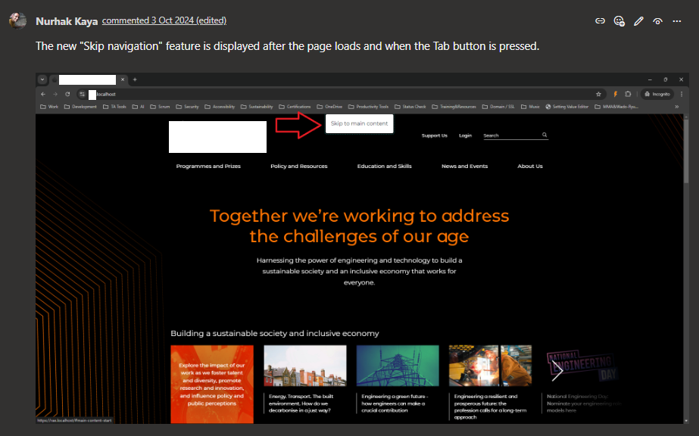
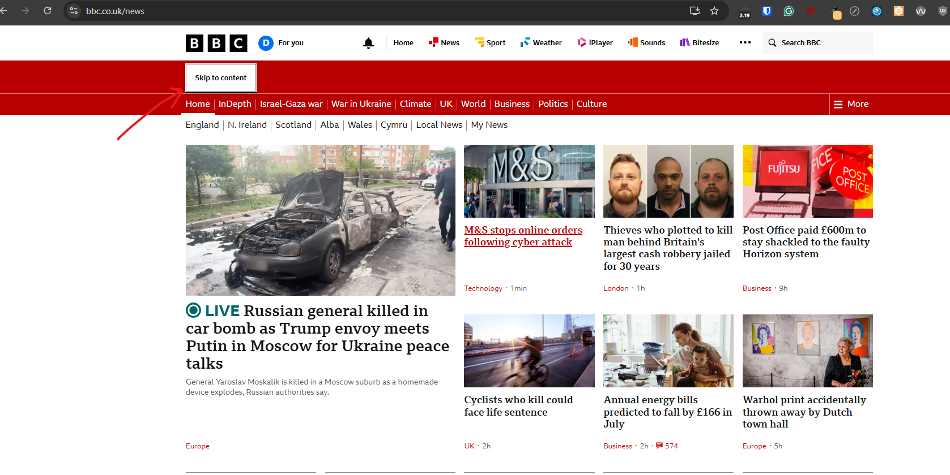
Enable full keyboard navigation
Ensure all elements can be accessed via tab/arrow keys.

Slide 37
Best Practices for Accessibility

Slide 38
Best Practices for Accessibility
Design with accessibility in mind from the start
Avoid retrofitting; build accessibility into planning.
Use ARIA landmarks appropriately
Mark navigation, main, banner, and content areas.
Ensure forms are accessible
Label inputs, use fieldsets for grouping, ensure keyboard interaction.
Caption videos
Provide text alternatives for audio content.
Regularly audit your site
Schedule periodic testing with tools and manual checks.

Slide 39
Integrating Accessibility into Workflow

Slide 40
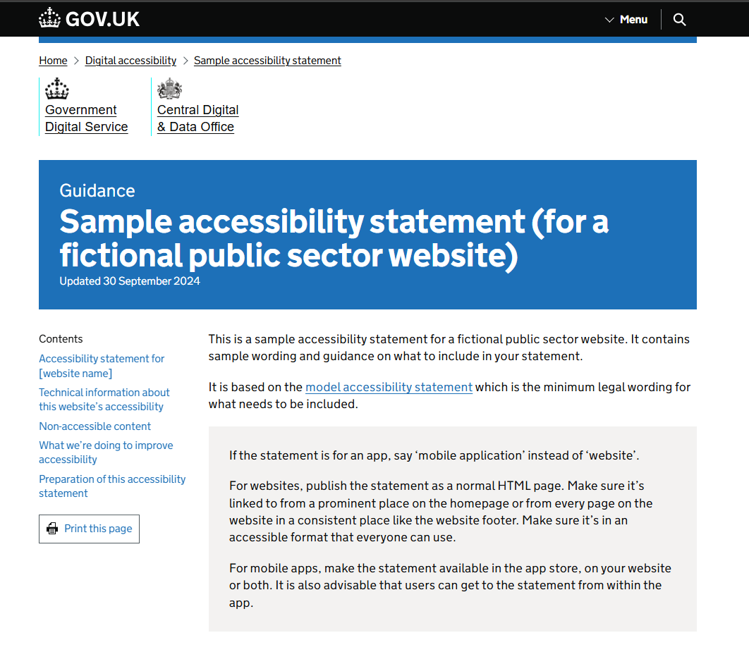
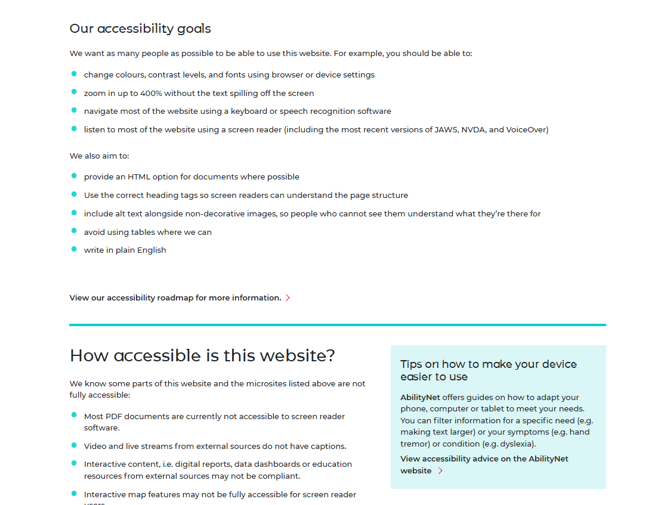
Integrating Accessibility into Workflow
Educate your team and clients
Train developers, designers, and content creators.
Help clients to create their accessibility statements.
Include accessibility in design reviews
Check for contrast, layout, and interaction early.
Automate testing with tools (Lighthouse, axe, etc.)
Integrate automated checks in your development pipeline.
Manual testing for real user experience
Combine tools with keyboard testing and screen reader use.

Slide 41

Thank you
Nurhak Kaya
https://www.linkedin.com/in/nurhak-kaya/
https://github.com/NurhakKaya
https://github.com/NurhakKaya/PracticalGuideToUnlockingAccessibilityOfWebsites

